Slide 1
Employee Data Analysis using Excel
STUDENT NAME:N.ASWATHI
REGISTER NO:312216533 autunm1647cc1221647002
DEPARTMENT:B.com (general)
COLLEGE:R.B.GOTHI JAIN COLLEGE FOR WOMEN

Slide 2
PROJECT TITLE
Employee Performance Analysis using Excel

Slide 3


AGENDA
Problem Statement
Project Overview
End Users
Our Solution and Proposition
Dataset Description
Modelling Approach
Results and Discussion
Conclusion
3/21/2024 Annual Review

Slide 4
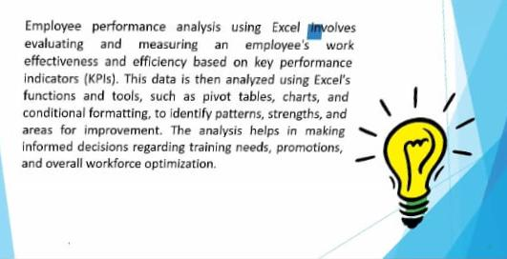

PROBLEM STATEMENT

Slide 5
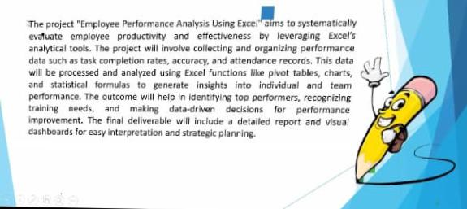

PROJECT OVERVIEW
.

Slide 6

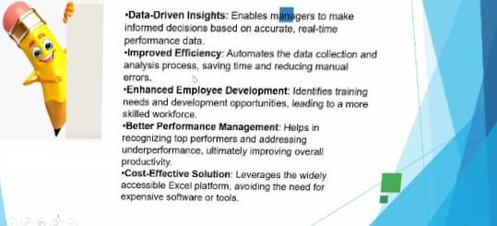
OUR SOLUTION AND ITS VALUE PROPOSITION

Slide 7
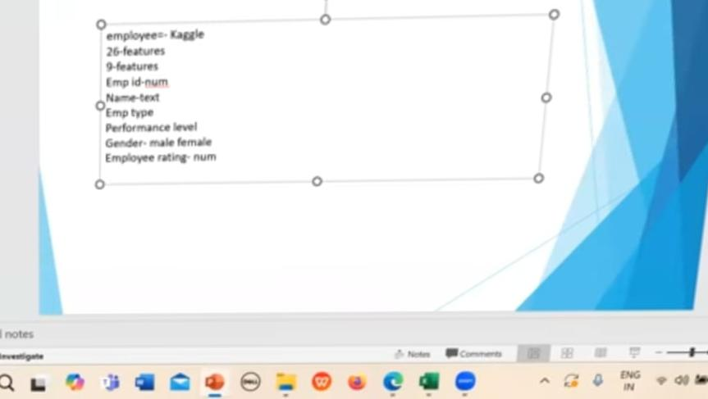
Dataset Description

Slide 8
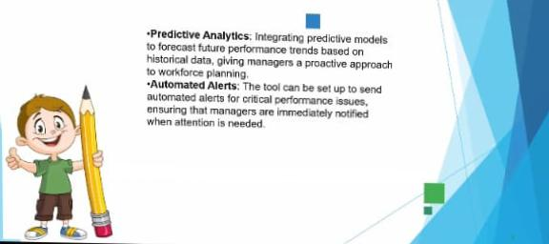

THE "WOW" IN OUR SOLUTION
3/21/2024 Annual Review
8

Slide 9
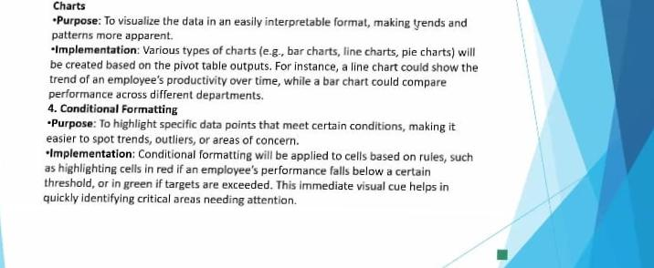
MODELLING
9

Slide 10
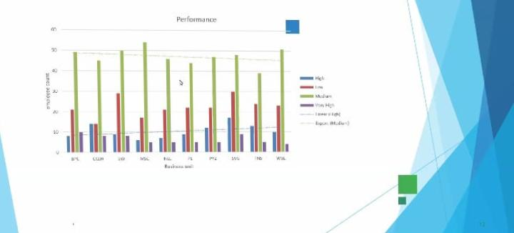
RESULTS
10

Slide 11
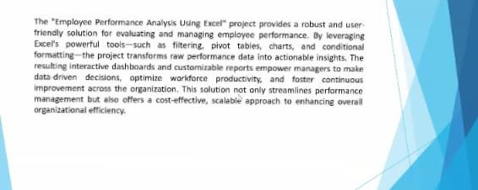
conclusion

